Slide 1

CodeX Check-In Project
Let the teacher know how you are doing

Slide 2
CodeX Check-In
Let your teacher know how you are doing by using your CodeX and its display screen filling it with color.
Grab your CodeX device…
Let’s write some code!

Slide 3
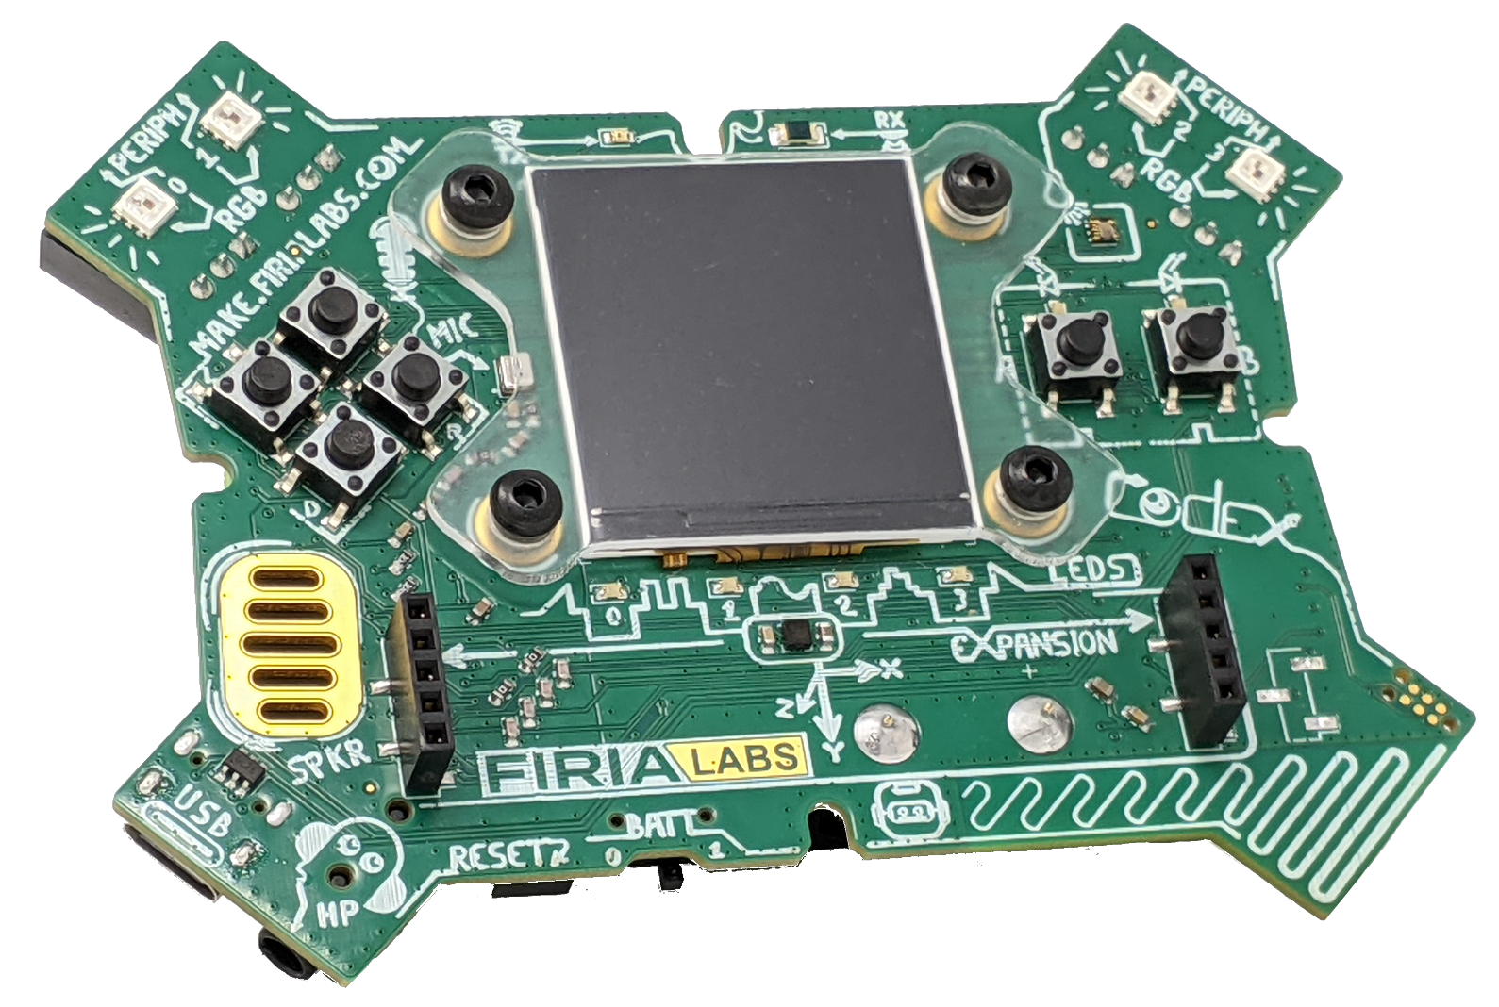
CodeX Buttons
The CodeX buttons will be used for input.
Identify the 6 buttons on the CodeX.
BTN_A
BTN_U
BTN_L
BTN_B
BTN_R
BTN_D

Slide 4
CodeX Buttons
Decide with your class what mood each button represents. Here is an example:
Up (BTN_U) = I’m doing great!
Down (BTN_D) = I’m okay.
Left (BTN_L) = I’m meh.
Right (BTN_R) = Struggling.
A (BTN_A) = Overwhelmed!
B (BTN_B) = Quit program

Slide 5
CodeX Buttons
Decide with your class a color for each mood.
Here are the colors you can use:
BLACK, BROWN, RED, ORANGE, YELLOW, GREEN, BLUE, PURPLE, GRAY, WHITE, CYAN, MAGENTA, PINK, LIGHT_GRAY, DARK_GREEN, DARK_BLUE

Slide 6
CodeX Buttons
Here is an example:
Up (BTN_U) = I’m doing great!
Down (BTN_D) = I’m okay.
Left (BTN_L) = I’m meh.
Right (BTN_R) = Struggling.
A (BTN_A) = Frustrated
B (BTN_B) = Overwhelmed!
DARK_GREEN
GREEN
CYAN
ORANGE
PURPLE
RED

Slide 7

Coding First Steps
You will use CodeSpace for this project.
Go to make.firialabs.com
Log in (use your account)
Go to the Sandbox
  Right side bar, near the bottom

Slide 8
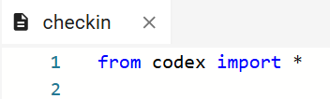
Start the program
In the text editor:
Start a new file: checkin
Import the codex library (module):
NOTE: spelling and capitalization matters!

Slide 9
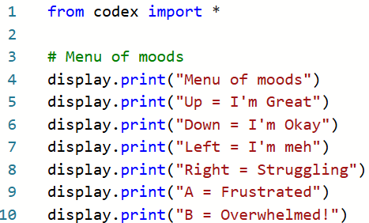
Step 1
Use print statements to display a menu of mood options. Here is an example:

Slide 10
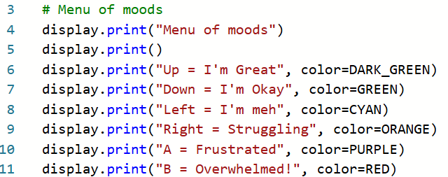
Step 2
You can add the color for each option.
Here is an example:

Slide 11
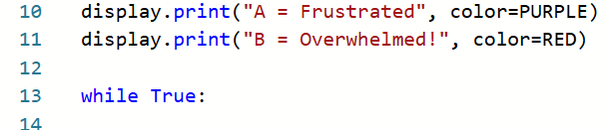
Step 3
Use an infinite loop to “wait” for a button press.
The loop will not end until you press a button.
The loop line of code ends with a colon (:)

Slide 12
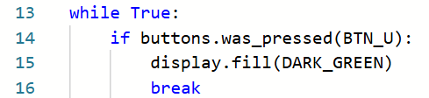
Step 4
Program the first button to fill the screen with the color of the mood.
This code must be indented below the loop.

Slide 13
Try it
Run the code
Press the
Press the “Up” button on the CodeX
Does the screen fill with a color?

Slide 14
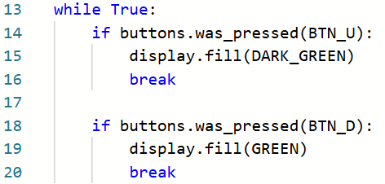
Step 5
Code more buttons.
Add code for each button.
You can copy and paste the code for the first button, and just change the button and color.
Do NOT copy the while True: line of code.

Slide 15
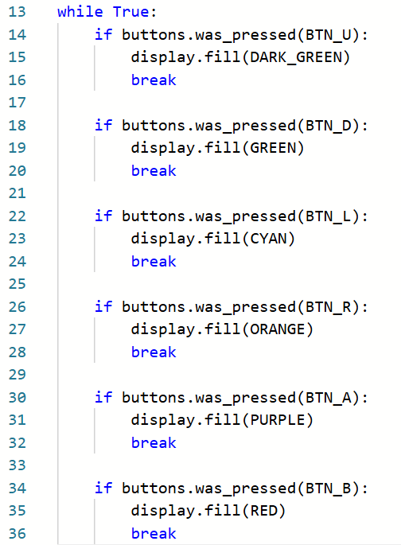
Step 5 - possible code
Be very careful with your indenting!

Slide 16
Finished!
Run the code whenever the teacher asks how you are doing.
Display your mood on the CodeX display screen.

